Slide 1
Data Visualization
4/4/2022

Slide 2
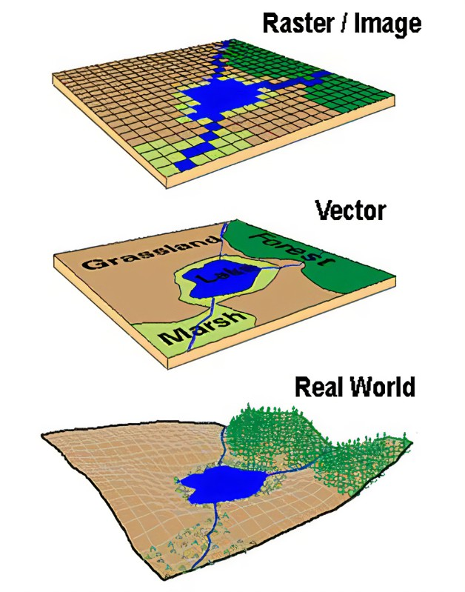
SPATIAL DATA
Spatial data is the data portrayed in points, lines and It can be represented in two dimensional and three dimensional forms.
Spatial data is any type of data that directly or indirectly references a specific geographical area or location. Sometimes called geospatial data or geographic information, spatial data can also numerically represent a physical object in a geographic coordinate system. However, spatial data is much more than a spatial component of a map.

Slide 3
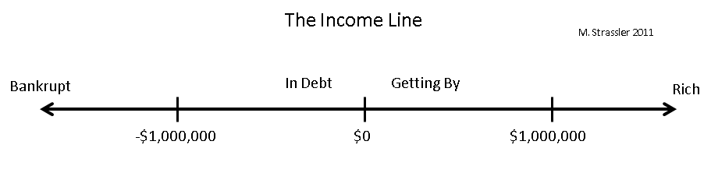
ONE DIMENTIONAL SPATIAL DATA
One dimensional spatial data is often the result of accumulating samples or readings of some phenomenon while moving along a path in space.
Given a one-dimensional sequence of univariate data (only one value per data item), we can map the spatial data to one of the screen dimensions and the data value itself to either the other screen dimension or to the colour of a mark or region along the spatial axis (to form a color bar).
The data needs to be scaled to fit within the range of the display attribute

Slide 4

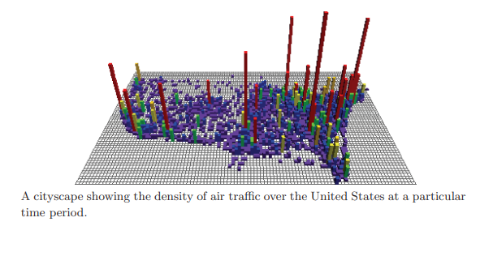
TWO DIMENSIONAL SPATIAL DATA
Data with two spatial dimensions gets visualized predominantly by mapping the spatial attributes of the data to the spatial attributes of the screen. The result can be one of the following visualizations:

Slide 5
PROBING TWO DIMENSIONAL DATA
Besides the visualization techniques that display the entire data set, we can also choose to visualize one-dimensional subsets, projections, or summarizations of the data.
After reducing the dimensionality in some manner, we are then free to employ any of the techniques described in the previous section.
Let us examine some of the projection options in detail.
1. Frequency histograms
2. Row and column aggregations.
3. Linear Probe

Slide 6
Frequency Histogram
We can summarize data sets of arbitrary dimensionality by computing the frequency at which values or subranges of values occur in the data, and then display this information as a bar graph.
Important considerations when using subranges are how to decide the number of sub ranges to use, and where the breaks between subranges should be.

Slide 7
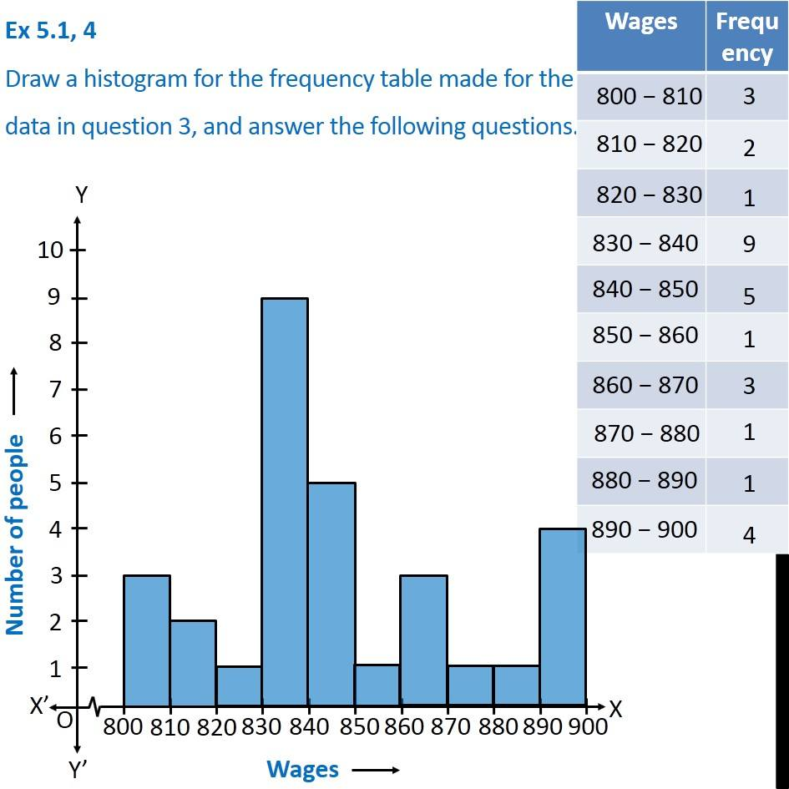
Frequency Histogram
A frequency histogram (or simply histogram) is used to graphically display the grouped frequency distribution.
Features of importance in the data might be lost if this is done incorrectly, and is best performed by someone extremely familiar with the data characteristics.
Simply dividing the range into a fixed number of evenly sized subranges, while simple, is rarely an effective strategy

Slide 8
Row and column aggregations
Visually depicting summarizations of the rows and/or columns of an image is a useful mechanism for localizing the boundaries of features of interest and regions of low or high variability.
Many descriptors can be used for this purpose, including the sum, average, median, standard deviation, maximum, or minimum values.
The resulting one-dimensional visualization can be viewed separately or, as often the case, placed alongside the two-dimensional visualization as supplemental information.
Color bars, line plots, and bar graphs have all been used with success in this type of visualization

Slide 9
Linear probes & Quadratic Probing.
A one-dimensional probe of a two-dimensional data set can be likened to a drill hole for mineral exploration. A line is passed through the data, and the values encountered are visualized using one of the one dimensional techniques previously described.
In Quadratic Probing, clusters are formed along the path of probing, instead of around the base address like in Linear Probing. These clusters are called Secondary Clusters and it is 'less visible' compared to the Primary Clusters that plagued the Linear Probing.

Slide 10
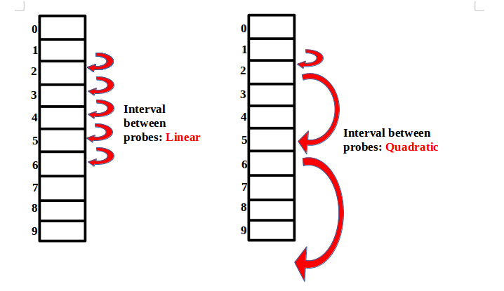
Linear and Quadratic Data Probing

Slide 11
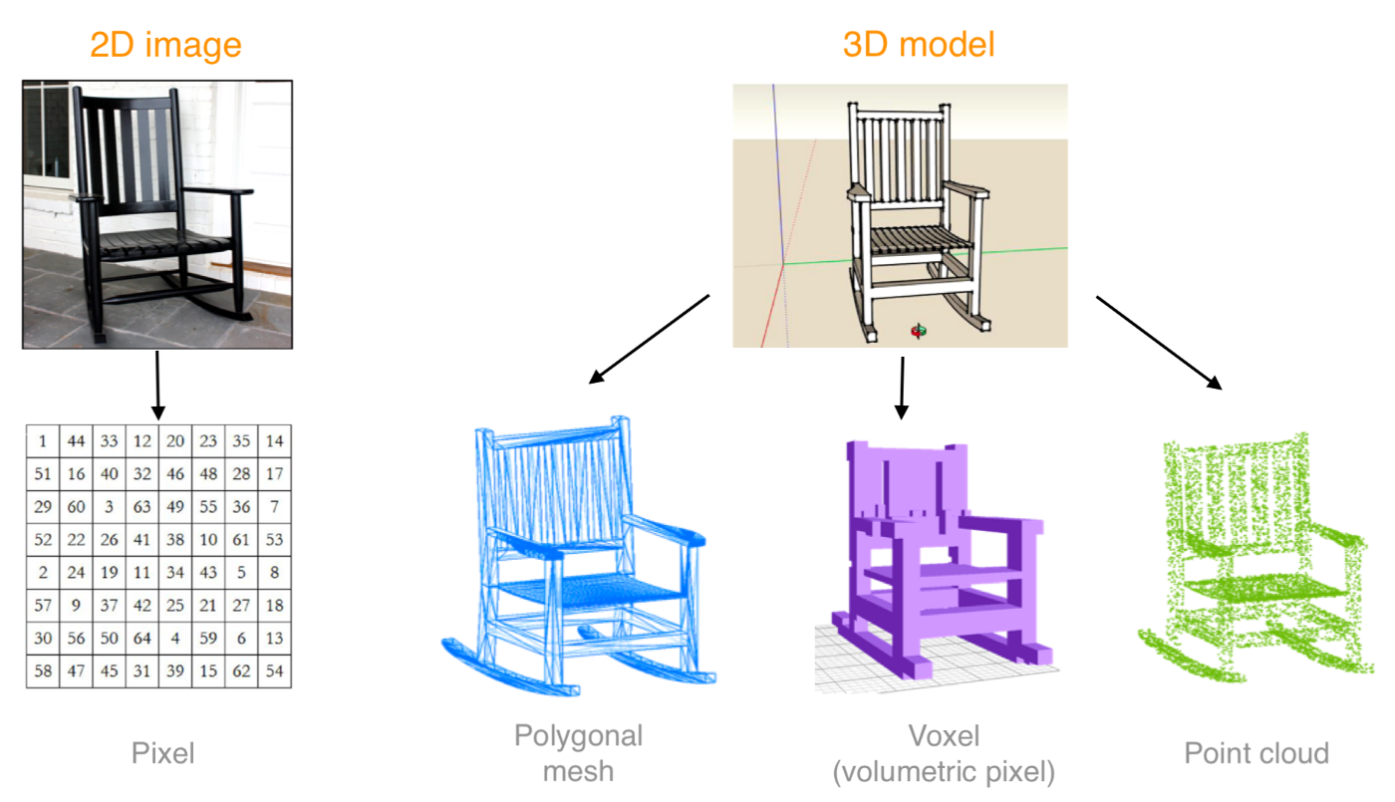
Three Dimensional Data
As with two-dimensional data, three-dimensional spatial data may be either discrete samples of a continuous phenomenon or a structure best described via vertices, edges, and polygons.
In reality, many visualizations of science and engineering data contain a combination of these data representations, such as air flow around a wing or stress attributes of a mechanical part.

Slide 12
Visualizing explicit surfaces
An explicit surface is one that has been defined in one of two ways:
1. A list of three-dimensional vertices, a list of connections between the edges (specified as a pair of indices into the vertex list), and a list of planar polygon patches (usually specified as a fixed or variable length list of indices into the edge list);
2. A set of parametric equations for defining the x-, y-, and z-coordinates of points on the surface, along with an interconnection strategy (e.g.

Slide 13
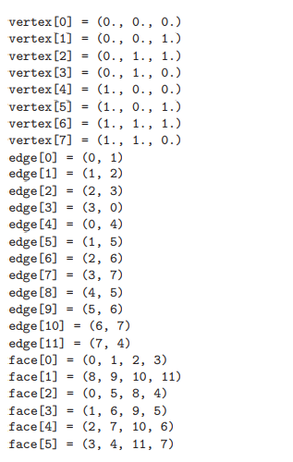
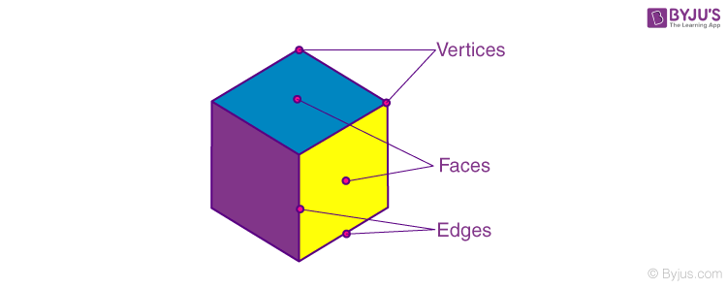
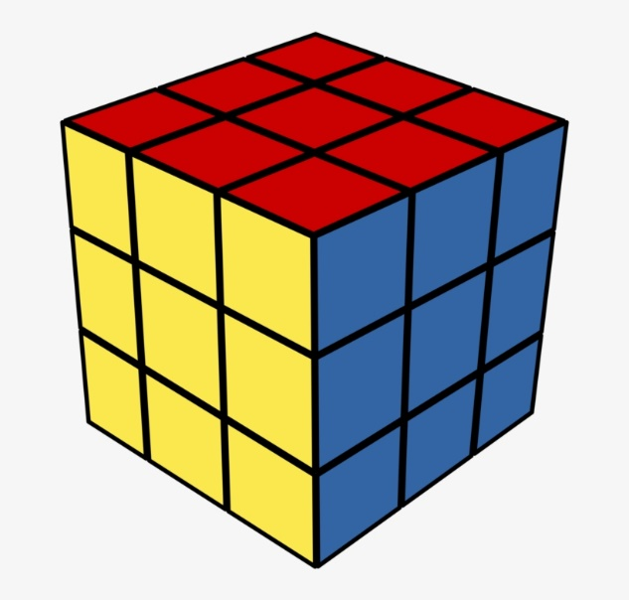
Note that every edge is shared by exactly two faces, and that every vertex is a member of two or more edges

Slide 14
PARAMETRIC REPRESENTATION
The parametric form for a unit cylinder aligned with the y-axis can be defined as follows:
y = 1.0, x = cos θ, z = sin θ, 0.0 ≤ θ ≤ 2π, (top)
y = 0.0, x = cos θ, z = sin θ, 0.0 ≤ θ ≤ 2π, (bottom)
y = h, x = cos θ, z = sin θ, 0.0 ≤ θ ≤ 2π, 0.0 ≤ h ≤ 1.0. (sides)

Slide 15
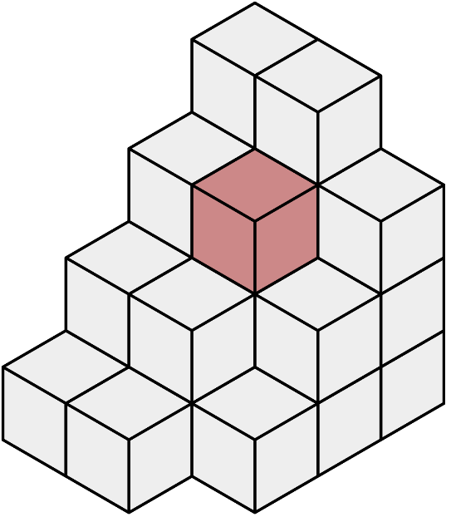

Voxel
In 3D computer graphics, a voxel represents a value on a regular grid in three-dimensional space.
Voxels are frequently used in the visualization and analysis of medical and scientific data (e.g. geographic information systems (GIS)). Some volumetric displays use voxels to describe their resolution
VOXEL
PIXEL

Slide 16
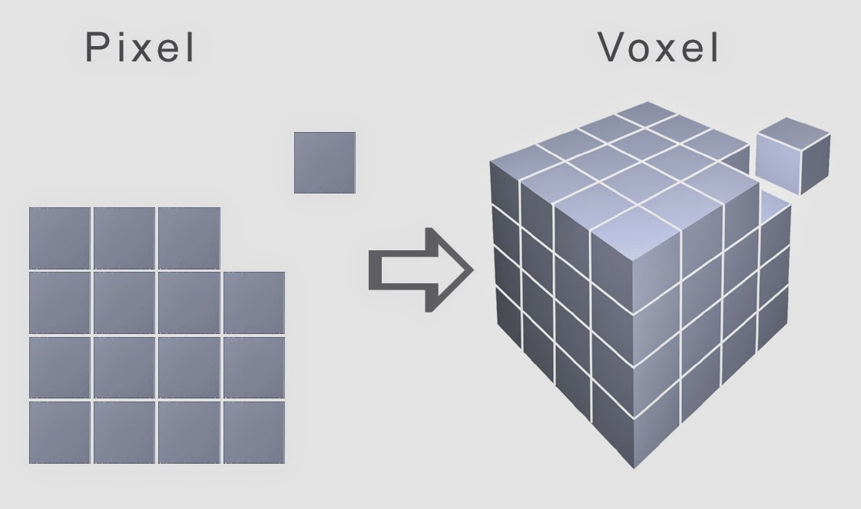
Pixel vs Voxel
The difference between a pixel and a voxel is that a pixel is a square inside of a 2D image with a position in a 2D grid and a single color value, whereas a voxel is a cube inside of a 3D model that contains a position inside a 3D grid and a single color value

Slide 17
Visualizing Volume Data
As pixels are to two-dimensional visualization, voxels, or volume elements, are three-dimensional visualization.
Volume data is generally a sampling of a continuous phenomenon, and can be either acquired via sensors (e.g., tomographic data sets) or generated via simulations (e.g., computational fluid dynamics).
In each case, we have one or more data dimensions with regular or irregular positions, and the goal is to convey to the viewer the structure, patterns, and anomalies within the data.

Slide 18
Contd.
Most approaches to visualizing volume data fall into one of the following categories:
Slicing techniques. Using a cut plane, either aligned with an axis or arbitrarily oriented, probe the data to extract a two-dimensional slice of the data, and then use one of the two-dimensional spatial data visualization methods.
Isosurface techniques. Given a user-specified value, generate a surface description and visualize it using one of the explicit surface visualization techniques.
Direct volume rendering. Either cast rays into the volume and compute a pixel value based on the data encountered by the ray, or project each voxel onto the projection plane using some method of accumulating effects on pixels.

Slide 19
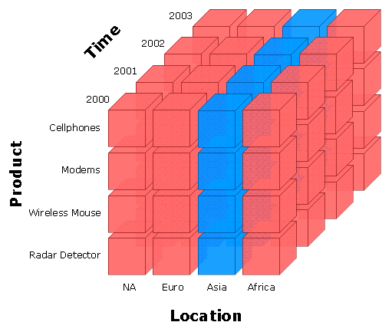
Slicing
The simplest implementation of this technique is to constrain the orientation of the cut plane so that its normal coincides with one of the data axes.
The user then specifies a row, column, or depth in the data block, and the corresponding slice is displayed using one of the techniques described in the section on two-dimensional spatial data visualization.
An effective strategy is to animate the slice selection so that the user can form associations between adjacent slices.

Slide 20
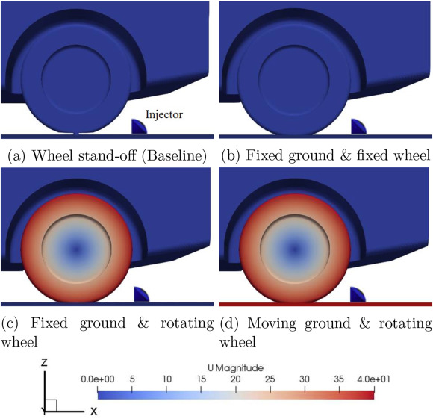
IsoSurfaces
An isosurface is a three-dimensional analog of an isoline.
It is a surface that represents points of a constant value (e.g. pressure, temperature, velocity, density) within a volume of space; in other words, it is a level set of a continuous function whose domain is 3D-space.
Isosurface is sometimes used more generically related to domains of more than 3 dimensions

Slide 21
Direct Volume Rendering
Direct volume rendering means that no three-dimensional polygons are created for use with traditional graphics rendering techniques.
Rather, pixels in the resulting image are computed on an individual basis, either by casting rays through the pixel through the volume, or by projecting voxels onto the plane of projection.
Volume Rendering is a visualization/graphics technique which directly renders data using a reasonable approximation to a physical light transport model.

Slide 22
